Slide 1

Experiment Design Briefing
Space Odditys
Palmetto Scholars Academy
Team #1
[Team Logo Here]
Notes:
Sam

Slide 2
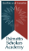
Agenda
Team Introduction
Team
Team Identity
Project Background and Requirements
Science Objective
Science Objective Selection and Instrumentation
Hypothesis
Experiment Design
Program Overview
Payload Design
Concept of Operations
Functional and Operational Testing
Functional Requirements and Testing
Functional Requirements and Testing
Outreach
Overview
Investigation
ICD Requirements Checklist
Lessons Learned
Summary
Notes:
Sam
In this presentation, we will first introduce the team before selecting a science objective and creating a hypothesis. We will then move over to experiment design with the program overview, payload schematics, and concept of operations. Afterwards, we will review the functional and operational testing, before moving into the Outreach and ICD Requirements checklist. Finally, the presentation will end with Lessons Learned and a summary.

Slide 3
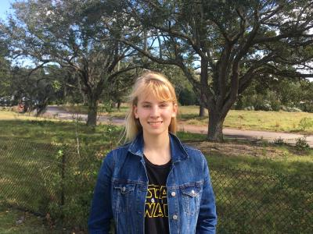
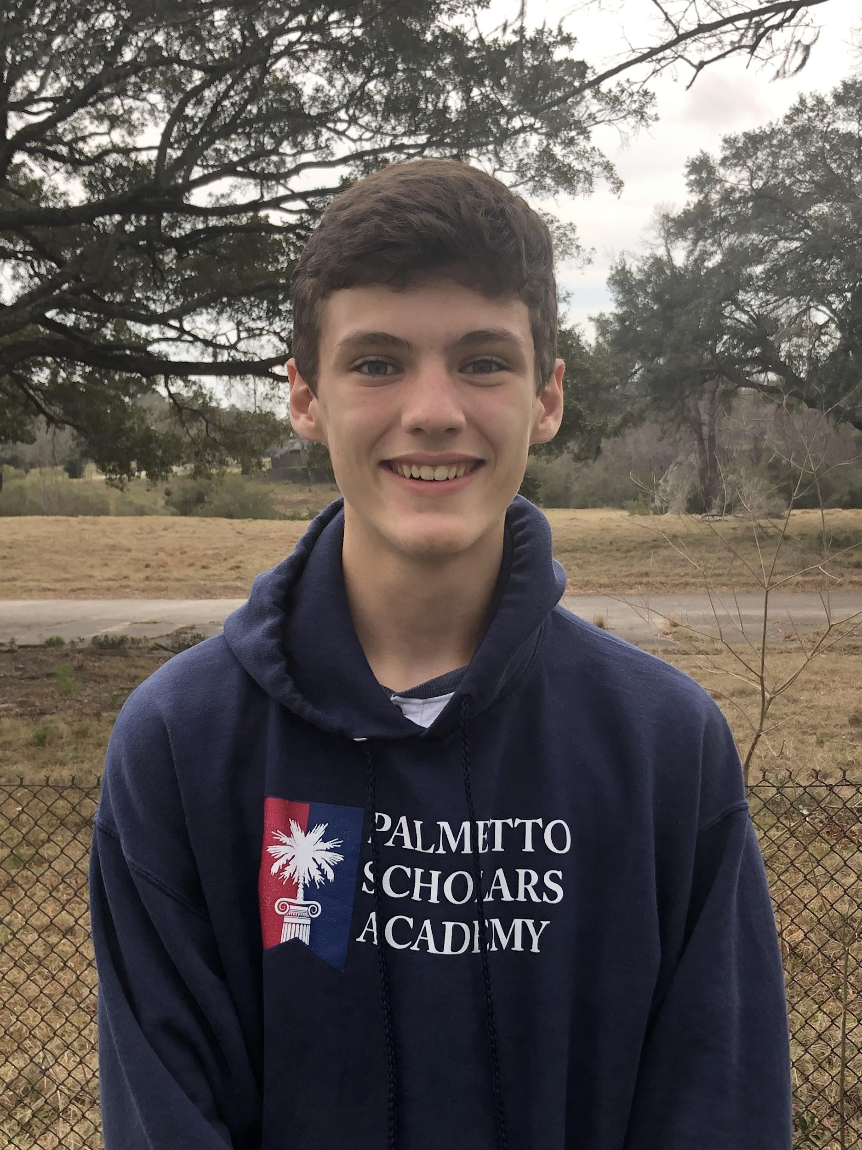

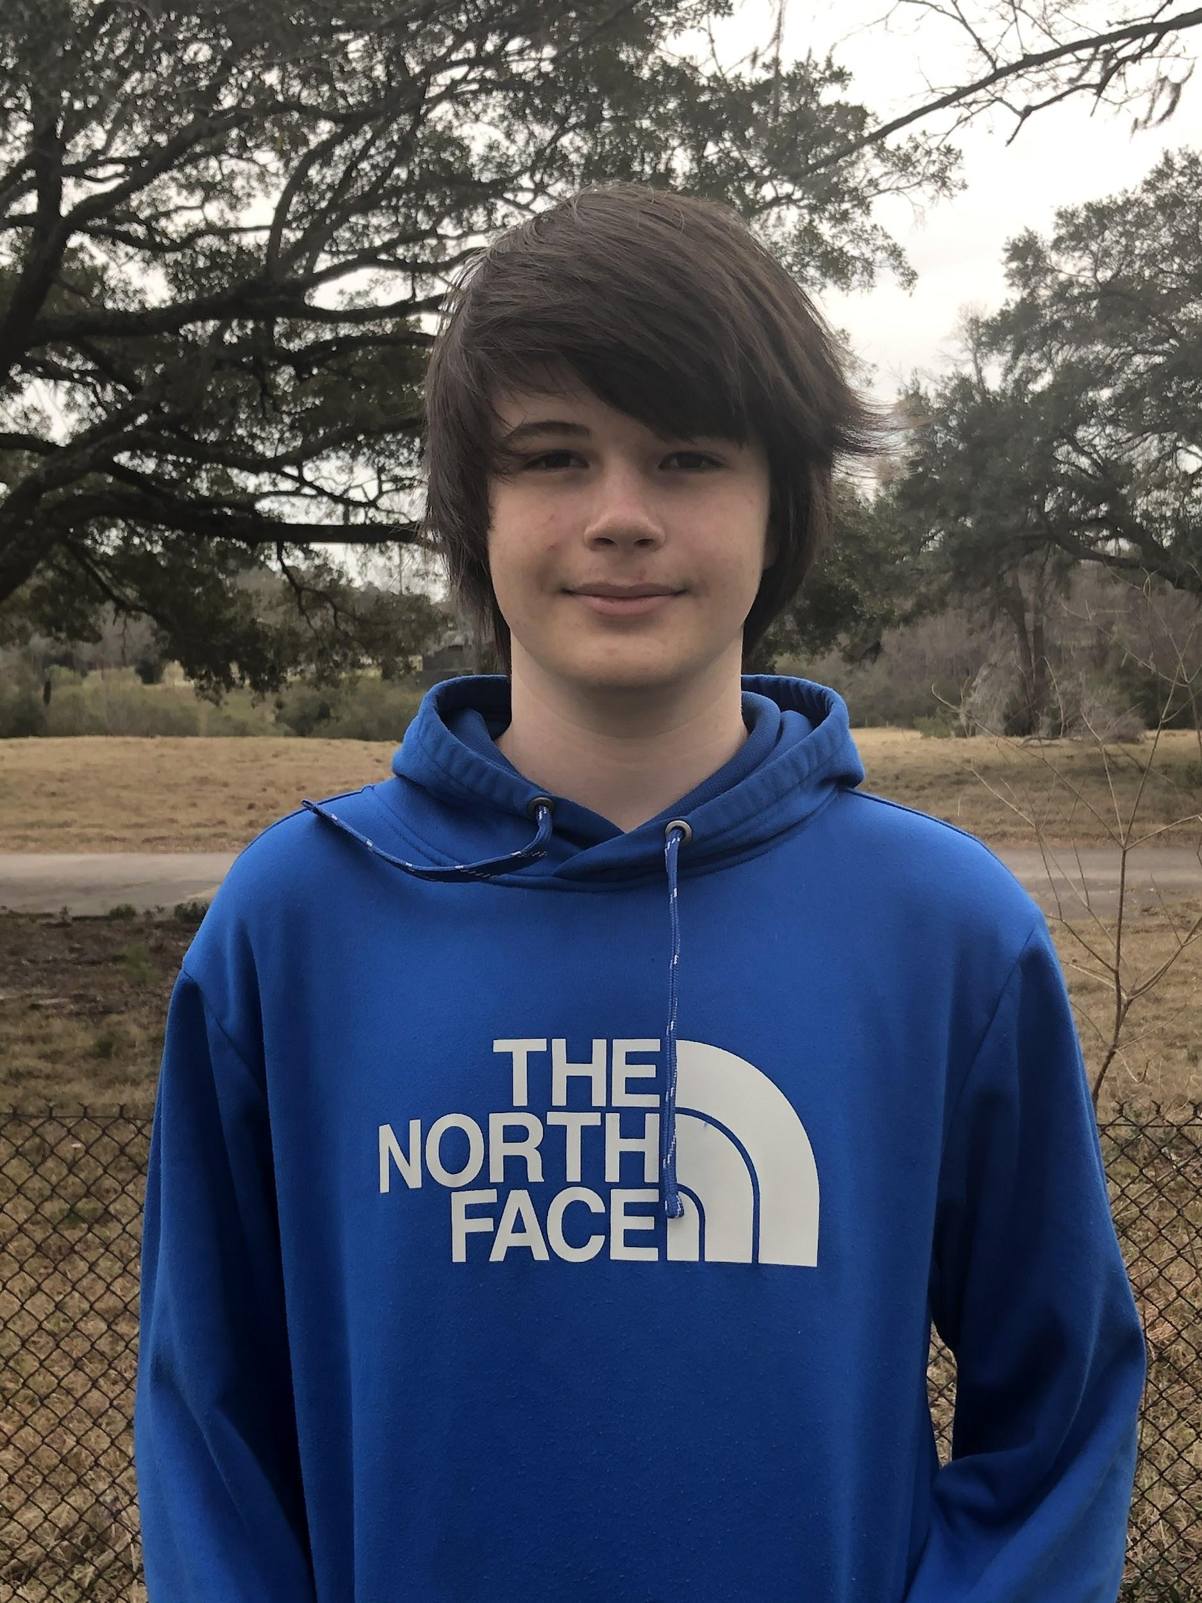
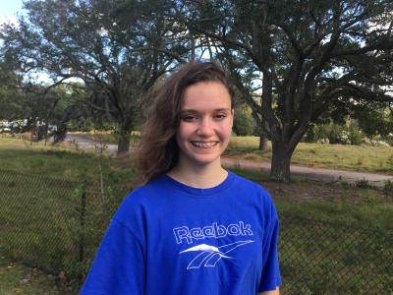
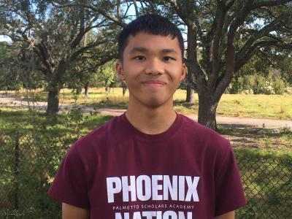
Team
Project Manager
Samantha
Quartuccio
11th Grade
Chief Engineer
Michael
Blunt
10th Grade
Test Lead
Dalton
Long
10th Grade
Program Lead
Benjamin
Deaton
10th Grade
Outreach Lead
Morgan
Peterson
10th Grade
Test/Program Group
Emann
Rivero
11th Grade
‹#›
Notes:
Everyone *Move Michael*
Sam > Michael > Dalton > Ben > Morgan > Emann (next slide)

Slide 4
Team Identity
“For here am I sitting in my tin can, far above the world”
Notes:
*Good*
Morgan
Our team wanted to continue with our trend of basing our team identity around famous bands and singers, the last competition we participated in with UAH we used the band Queen, this time we have gone with David Bowie. Our logo is the earth, our view from the space station, and the famous bowie lighting bolt. Our name as you know is the “Space Oddities” which alludes to one of his songs, “Space Oddity”, our slogan is a line from the song “for here I am sitting in my tin can, far above the world”. We thought this was fitting to use because it somewhat describes the ISS where our payload is going to possibly end up and the end of this project.

Slide 5
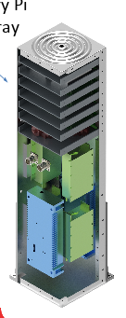
Project Background
AR2A ISS Experiment is an external pallet experiment sponsored by U.S. Space and Missile Defense Command
Objectives:
Space qualify quantum entanglement Commercial-Off-the-Shelf (COTS) hardware
Investigate space environment effects on quantum random number generator
Investigate low-cost COTS small satellite technologies
Schedule
January 2021 – ship to pallet integrator
December 2021- launch to ISS
Planned lifetime of one year on orbit
Raspberry Pi
Array Tray
Notes:
Ben
The ACES Red 2A Payload ISS Experiment is an external pallet experiment sponsored by U.S. Space and Missile Defense Command
It consists of 3 different objectives. We will focus on the third objective, investigating low cost small satellite technologies using Raspberry Pis.
If chosen, the schedule should consist of the payload being shipped to the pallet integrator in January of 2021. In December of the same year, the payload will be launched to the ISS where the year long experiment will take place.

Slide 6
Project Requirements
Mechanical/Spatial Requirements | Electrical Requirements
Sensors fit within a 65mm x 56.5mm x 19mm Can survive launch environment Cannot interfere with the rest of the mission | Pinout must be the same as the one found on the Raspberry Pi 3B+ Hat/Shield must be compliant with Pinout
Material Requirements | Software Requirements
Sensors purchased from reputable source Cost no more than $50 per team Compatible with Raspberry Pi 3B+ | Develop software on a Raspberry Pi 3B+ with the WiringPi or Pi4J libraries. Software must operate the Pi Data rate must not exceed 5 kilobytes per second. (5kBps)
Notes:
Ben
Mechanical requirements include a size of 65 x 56.5 x 19 millimeters, launch environment survivability, and the project cannot interfere with the rest of the mission. The pinout must be the same as the one found on the Pi, and should also be compliant with our Pi hat. Our sensors and materials should be purchased from reputable sources and be no more that 50$. Our software must be developed on the Pi and operate the pi hat. Our data rate must also not exceed 5 kilobytes per second. Next slide please

Slide 7
Science Objective Selection
Notes:
Ben

Slide 8
Potential Science Objectives
Electromagnet Strength in Space
Investigation of Earth’s magnetic field effects on EMF Strength
Interfacing Hall Sensors measuring electromagnet’s EMF
Discover beneficial data for future space flights that used equipment sensitive to magnetic fields
Fiber Optic Cables in Space
Investigation on speed and efficiency over time of fiber optic cables in microgravity conditions compared to on Earth
Standard and space-grade Fiber Optic Cables
Testing of prominent instrument in space travel
Degradation of Pharmaceuticals in Space
Investigation into effects of microgravity enclosed environment on potency drop-off and shelf life of certain medicines and drugs
Chemical Potency Sensor on tablet
Discover shelf-life of important medications for future space travel
Notes:
*Make order match slide 9
Ben
Our first potential science objective was the study of earth’s magnetic field on EMF strength. This would provide beneficial data for future space flights that used equipment sensitive to magnetic fields.
Our second potential science objective was investigating the speed and efficiency of standard and space grade fiber optic in space. We hoped to determine the differences between the two, which could have helped save some of the money spent on space grade fiber optics.
Our third potential science objective was the degradation of pharmaceuticals in space. This would be an investigation into the effects of a low gravity, isolated environment on certain types of drugs and pharmaceuticals.

Slide 9
Science Objective Trade Study
FOM | Weight | Electromagnet Strength |  | Fiber Optic Cables |  | Pharmaceutical Degradation
 |  | Raw | Weighted | Raw | Weighted | Raw | Weighted
Interest of Team | 9 | 9 | 81 | 3 | 27 | 9 | 81
Measurement Method | 9 | 9 | 81 | 1 | 9 | 3 | 27
Success Likelihood | 9 | 9 | 81 | 3 | 27 | 3 | 27
Sensor Simplicity | 3 | 3 | 9 | 9 | 27 | 1 | 3
Sensor Resolution | 3 | 3 | 9 | 1 | 3 | 1 | 3
Scientific Ramification | 1 | 9 | 9 | 3 | 3 | 9 | 9
Public Interest* | 1 | 9 | 9 | 3 | 3 | 9 | 9
Program Simplicity* | 3 | 9 | 27 | 3 | 9 | 3 | 9
Test Reliability* | 9 | 9 | 81 | 9 | 81 | 3 | 27
TOTAL |  | 387 |  | 189 |  | 195
Notes:
In this scientific objectives trade study, the figures of merit or FOMs were Interest of Team, Measurement Method, P Success Likelihood, Sensor Simplicity, Sensor Resolution, Scientific Ramification, Public Interest, Program Simplicity and Test Reliability. They were weighted on a scale of either 1, 3 or 9. The Science Objectives were then given a score for each FOM, either 1,3, or 9, and then multiplied by the weight to give a final score. Electromagnet Strength was chosen as the team’s science objective due to a high measurement method, Likelihood of success and test reliability scores *include a mention of which FOMs were created by us by UAH*

Slide 10
Science Objective Chosen
Effects of Earth’s Magnetic Field on EMF Strength
Meets functional and programming requirements outlined in the Request for Experiment (RFE) and the Interface Control Document (ICD)
Pros
Reliable sensor with high accuracy
Fits environmental constraints
Very low risk
Easy Replicability
Low cost
Scientific Impact: May influence future missions using:
equipment sensitive to magnetic fields
wires with large currents flowing through them
Cons
Difficult to assemble
Lack of knowledge in the field
Notes:
*Fix wordy (last) bullet point
Ben
Our Science Objective is researching the effects of earth’s magnetic field on EMF strength. This objective complies with the requirements outlined in the RFE and ICD, as does the payload design. To collect data we will be using an HMC5883L magnetometer and the Grove Pi Electromagnet. The pros of this objective include a Reliable Sensor, Low risk, meeting environmental constraints, easy replicability, and a low cost. The Cons are that it is difficult to assemble, and we lacked knowledge in the field which means we had to spend a great deal of time on research.
All in all, the possibilities of this experiment are vast. The data from this mission could be critical data to future space flights containing equipment sensitive to magnetic fields, high current wiring may produce a stronger magnetic field than anticipated.

Slide 11
Science Traceability Matrix
Science Objective | Measurement Objective | Measurement Requirement | Instrument Selected
Effects of Earth’s Magnetic Field on EMF Strength | Measure effects on electromagnet outside of Earth's magnetic field | Produce a stable electromagnetic field Take regular measurements of strength of field | Grove Pi Electromagnet
 |  |  | HMC5883L magnetometer
 | Compare results against baseline on Earth | Take baseline measurements of strength of field on Earth
Notes:
Sam/Ben (Tentative Sam)
This is our science Traceability matrix. Our science objective, the effects of Earth’s magnetic field on EMF Strength,

Slide 12
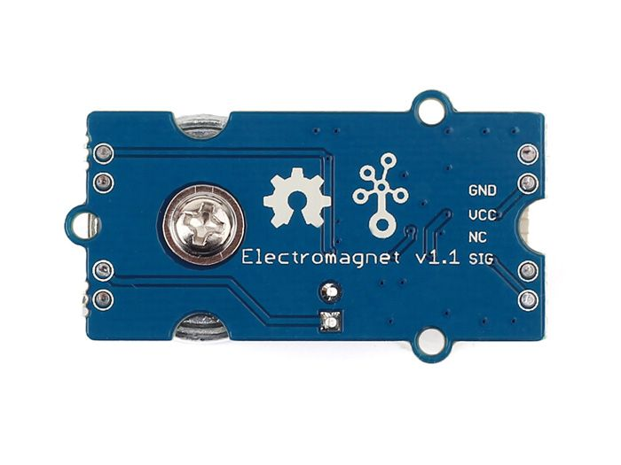
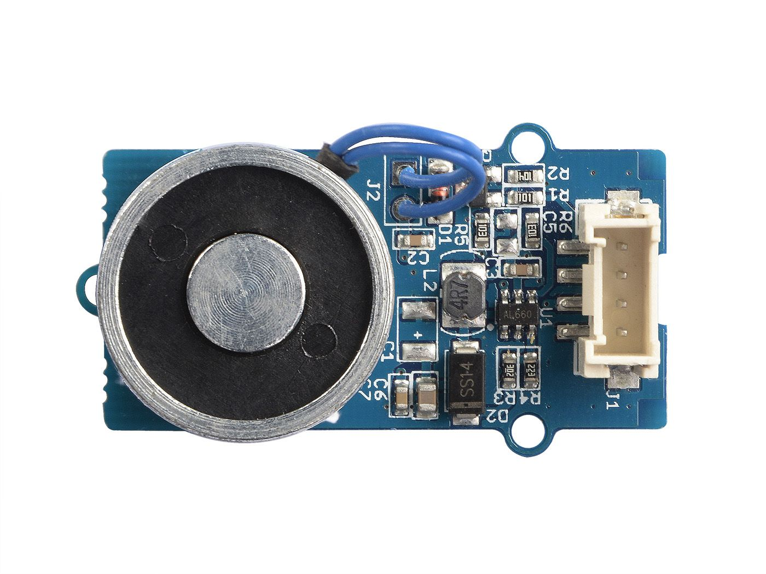
Electromagnet - Grove Pi Electromagnet
The Grove Pi Electromagnet is a small electromagnet developed specifically for Raspberry Pis.
Physical and Data Transfer
Dimensions: 40mm x 18.8mm x 18.8mm
Secured mounting by a screw on back.
Special digital connector that links easily onto Pi .
Electromagnet transfers data over “SIG” wire.
Notes:
*22mm limit
Ben
We will be using the Grove Pi electromagnet to conduct our research
The Electromagnet is 40mm x 18.8mm x 18.8mm, and is held in by a screw on the back. This screw will be used to mount the electromagnet to a holder on the payload. More Importantly, we knew that the requirement was 19mm and were assured by UAH that 19 mm is the safety height of the tray, and the tray actually is 22mm, so we are still within safe limits even though our payload is close to the 19mm limit.
It has a special digital connectors that link easily onto the Pi, and the electromagnet transfers data over a “SIG” wire, seen in the picture.
next slide please

Slide 13
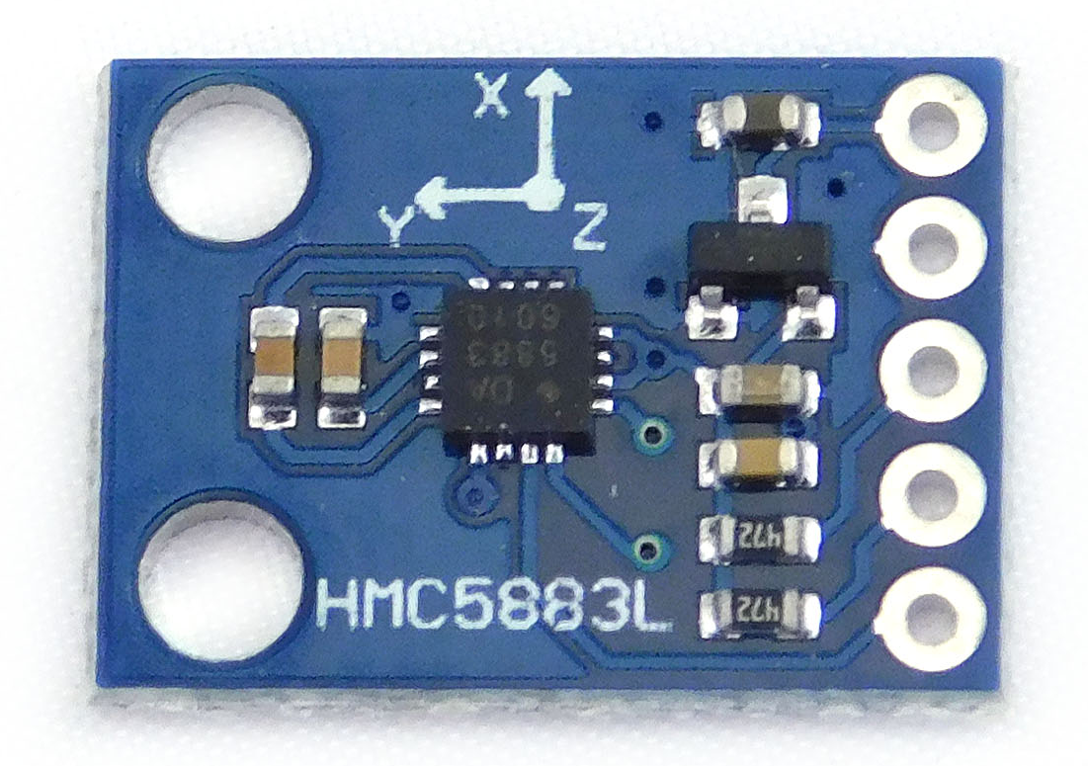
Magnetometer - HMC5883L
The HMC5883L is a high accuracy magnetic field sensor that has been used in ICS for many years.
It is rated to survive:
3,000G for 0.5ms
10,000G for 0.1ms
-40°C to 85°C (operating temperature)
-40°C to 125°C (storage temperature)
Sensitivity
Measures EMFs with a factory calibrated accuracy of +/- 0.004G
We have found this number is closer to +/- 0.005G
Physical and Data Transfer
The HMC5883L is 18.5mm x 13mm x 2mm
The HMC5883L is an I²C bus slave, and transfers data over a serial data line
Notes:
Michael
*good*
Our sensor is highly reliable and has been used in Industrial Control Systems for many years.
It is rated to survive conditions much more extreme than required in the ICD.
The sensor measures magnetic fields with a factory calibrated accuracy of plus or minus 4 milligauss
Our sensor is very small, measuring two millimeters by two millimeters by one millimeter
However, the PCB board the sensor is mounted on is eighteen and a half millimeters by thirteen millimeters by two millimeters
The connection plates are also very small, and will be soldered by a microelectronics professional using specialized equipment
Our sensor is uses the I2C protocol to transfer data.
next slide please

Slide 14
Hypothesis
Research Question
To what extent does Earth’s magnetic field affect the strength of EMFs?
Hypothesis
As the payload travels farther away from Earth’s surface, the magnetic strength of our electromagnet will increase due to the decrease in the strength of Earth’s (interacting) magnetic field.
Notes:
*Wordy, cut down {maybe keep the sentence to speak and trim it down into bullet points}*
Sam
The research question for the payload experiment is “To what extent does Earth’s magnetic field affect the strength of electromagnets?” and from that we derived our hypothesis.
Along the lines of the theory of electromagnetic interaction, we believe that as the payload travels farther away from Earth’s surface, the magnetic strength of our electromagnet will increase due to the decrease in the strength of Earth’s (interacting) magnetic field.
Currently, the electromagnet is being influenced by a ~0.23 gauss strength (+/- 0.005 gauss) from Earth’s magnetic field in its current situation. With the removal of this interacting force, we expect a notable increase in the strength of the electromagnet.

Slide 15
Experiment Design
Notes:
Ben

Slide 16
Program Overview
The program consists of 6 major parts. We have a control program, a magnet program, a transfer program, a monitor program, UAH’s program, and a restart program.
Control Program launches all programs needed for the mission
Monitor Program will restart system if a program isn’t working
The rest of the program is designed around collection and exportation of the data
Also included are troubleshooting and calibration programs.
Notes:
Ben *change the flowchart into a seperate slide, also mention the two functions on the left (maybe Michael adds a footnote at the end of this slide)*
The six major parts of our program are the Control, Magnet, Transfer, Monitor, UAH, and Restart programs. It works so that our Control program will be launched at the start of the mission, and will proceed to launch all other programs needed for the mission. The Monitor program is there to restart the system if a program falters after launch. The rest of the program is designed to collect and export data while running and stopping the magnet to maintain a compatible environment.

Slide 17
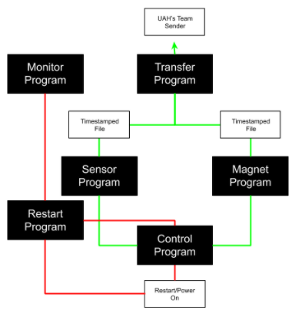
Program Flowchart
Shown is a flowchart of our program operation.
The green line represents normal operation
The red line represents a restart operation
Notes:
Michael
Here is a visual representation of our program function. In a normal operation cycle, immediately after boot up the control program will: start the magnet and sensor program, and start a 60 minute reboot timer. The magnet and sensor program will then output data in the form of timestamped JSON files, which are placed in the /tmp/experiment folder by the transfer program. This data is then handled by UAH’s team sender. A restart is triggered if the 60 minute reboot timer finishes or the monitor program detects a malfunctioning or stopped program.

Slide 18
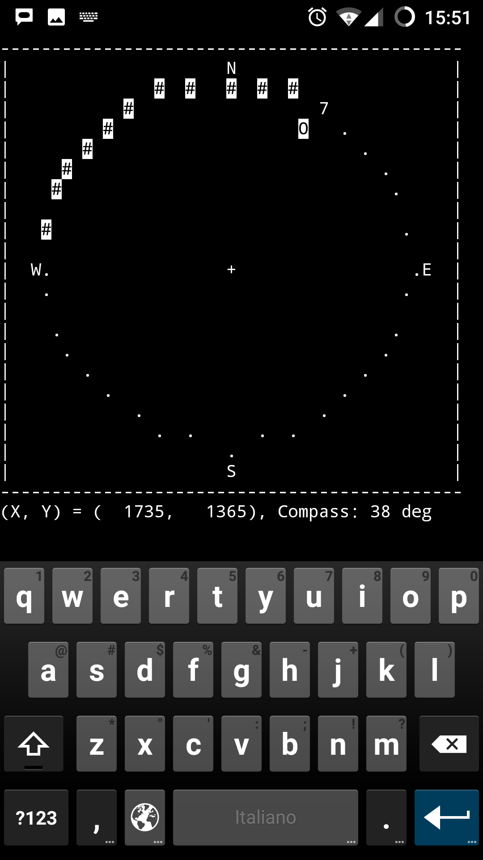
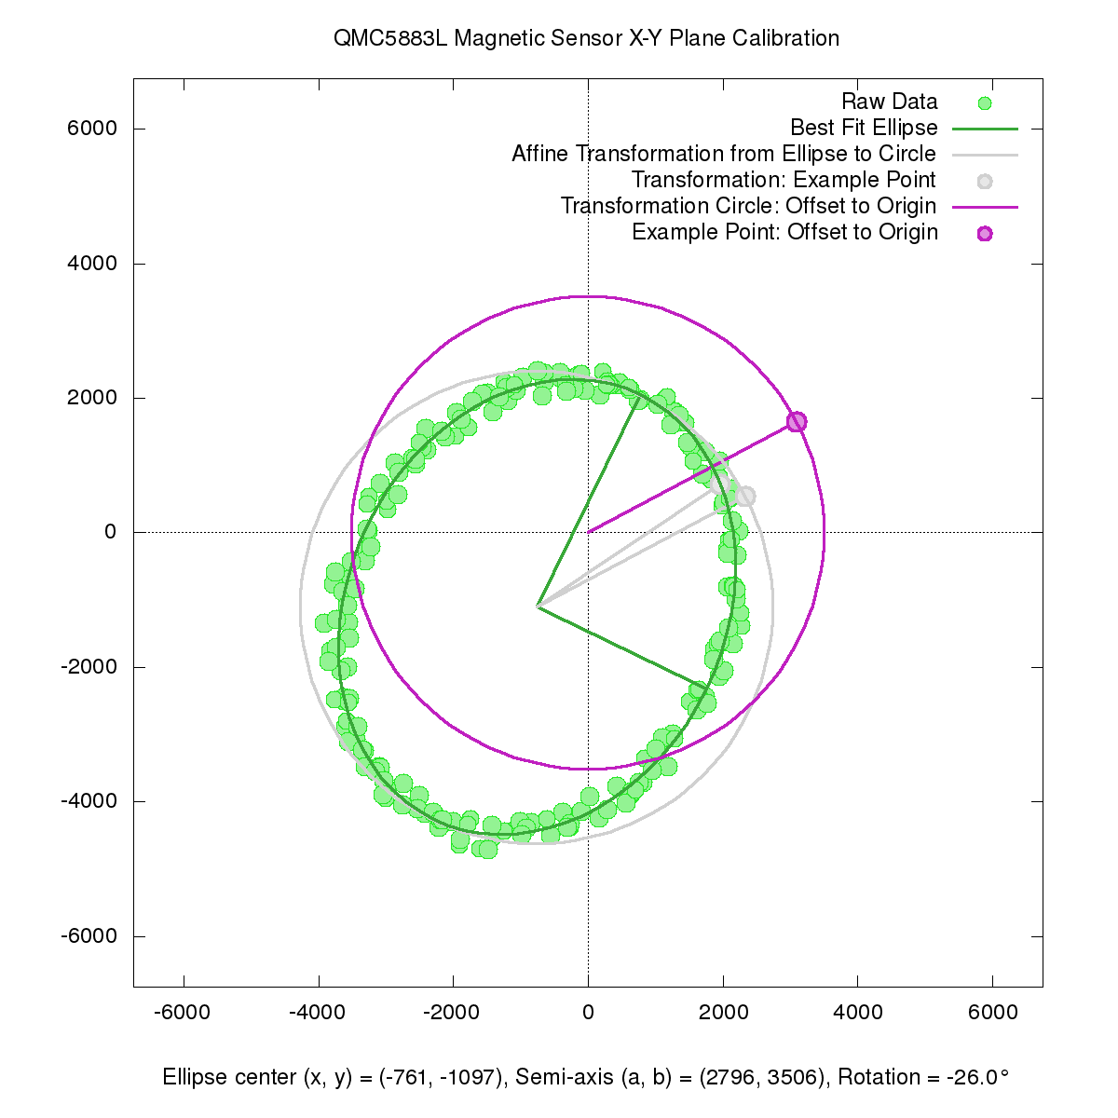
Magnetometer Calibration Programs
With our programs we include a calibration program to ensure data accuracy
Magnetometer is rotated on a level surface
Command line program returns current matrix
Correction program shows correction needed
Correction program outputs correction matrix
Correction matrix added to code, and magnetometer is calibrated
Notes:
We took extra measures to ensure data accuracy, and included with our programs is a calibration program. First the command line program, seen in the top right, is run. The calibrator then rotates the magnetometer three hundred and sixty degrees on a level surface until enough data has been collected. After sufficient data is collected, the command line program outputs a matrix. The calibrator then inserts this matrix into the correction program, seen in the bottom right, and receives a correction matrix, which can be easily entered into the sensor program to calibrate the sensor.

Slide 19
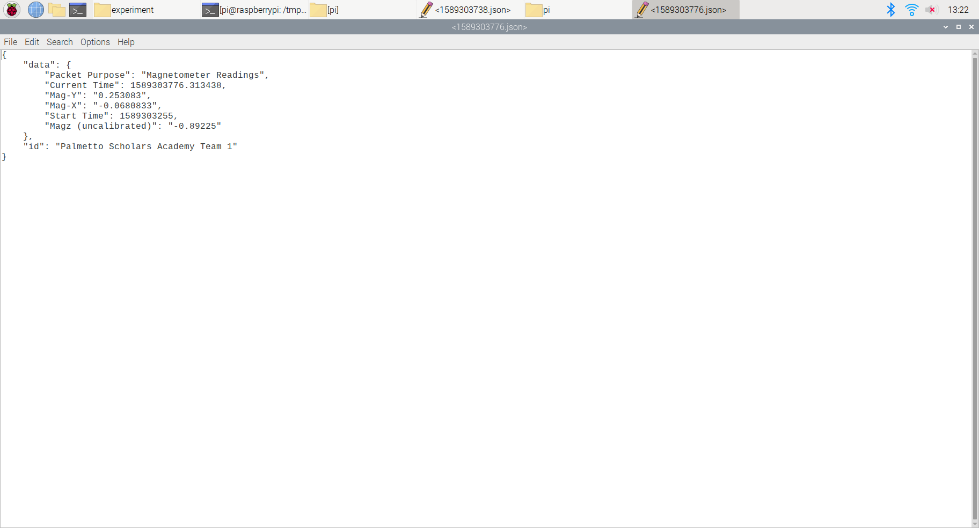
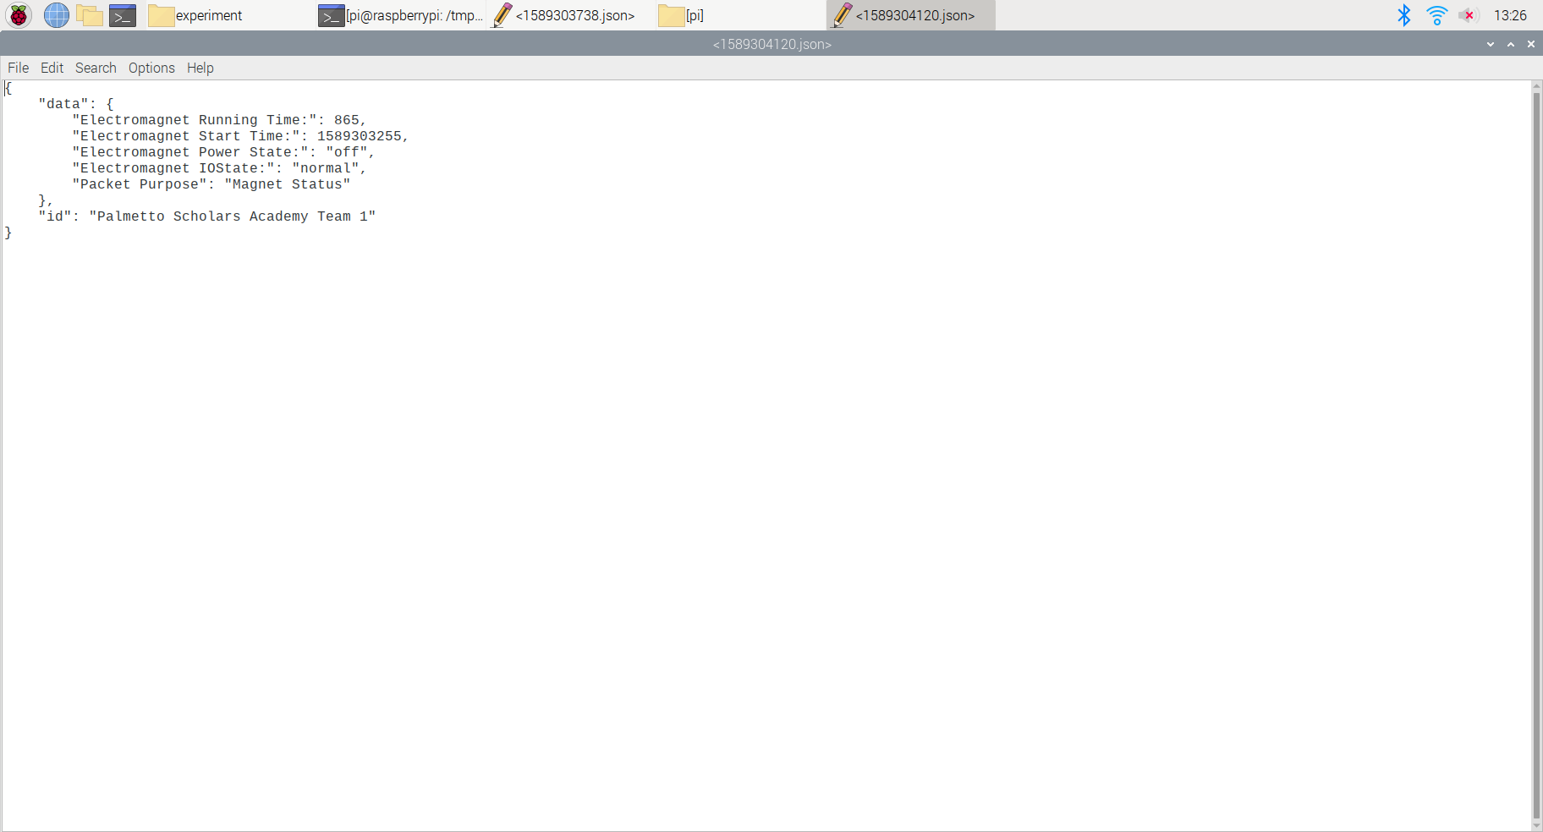
Data Packet
The top data packet is from the electromagnet.
Included is the start and running time, as well as the current power and Input/Output state.
The bottom data packet is from the magnetometer. It includes:
Magnetometer Readings
Start and Current Time
All packets outputted are approximately 0.3kB (+/- 6 bytes)
Data rate will not exceed 0.6kBps
Magnetometer Data Packet
Electromagnet Data Packet
Notes:
Michael
Our experiment produces two kinds of data packets, an Electromagnet Data packet and a Magnetometer Data Packet. The Electromagnet data packet is sent once every three and a half minutes and is a simply a status packet. The magnetometer data packet is sent out every second and includes data from the X, Y, and Z axis. The normal data rate is 0.3 kilobytes per second, unless an electromagnet packet is sent out simultaneously, which results in a data rate of 0.6 kilobytes per second. Assuming normal continuous operation and hourly reboots, our experiment will collect eight-five thousand six hundred and eighty readings.

Slide 20
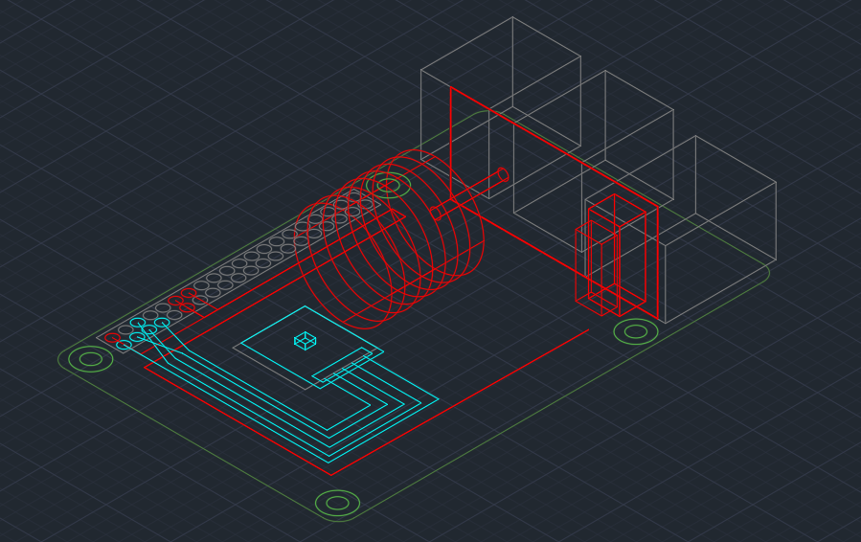
Configuration - 3D CAD Model
Notes:
Michael
This is a 3D CAD model of our payload.
The red represents the electromagnet and its components, while the blue represents the magnetometer and its components.
The largest red cylinder is the electromagnet, and the tiny blue rectangular prism is the magnetometer.
The green and grey objects are normal components of the Pi included in this Model for reference.

Slide 21
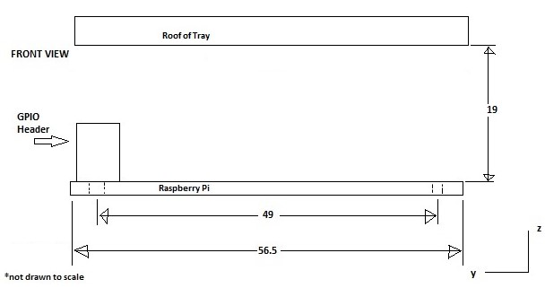
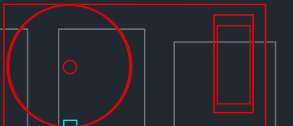
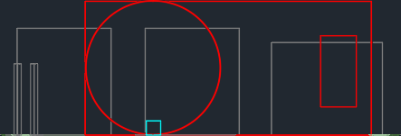

Configuration - Front View
18.8mm
18.8mm
15mm
10mm
1mm
Notes:
Michael
Here is a 2D model of our payload as seen from the front
As shown by the white measurement lines, we are in compliance with the 19mm height limit given by UAH.

Slide 22
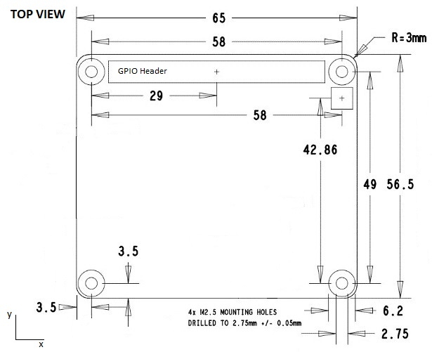
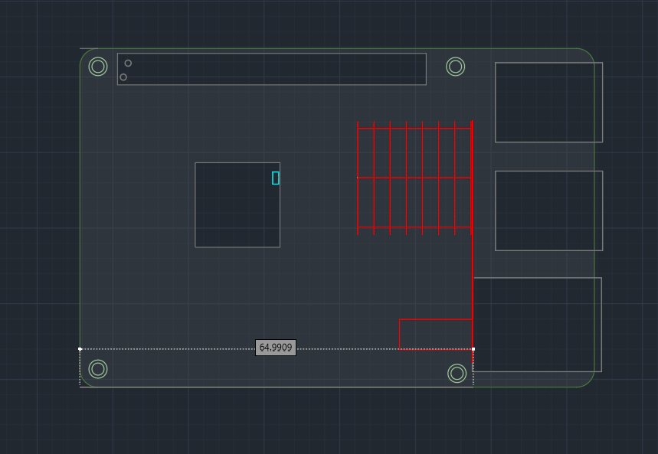
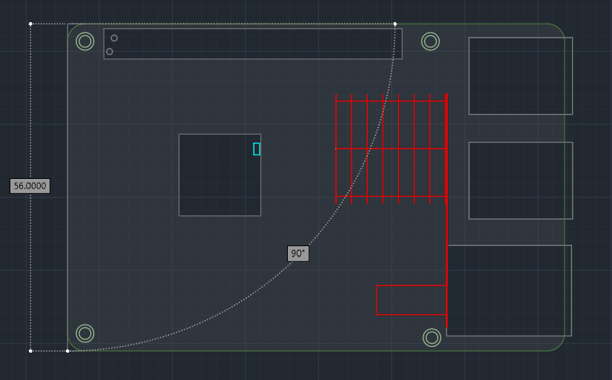
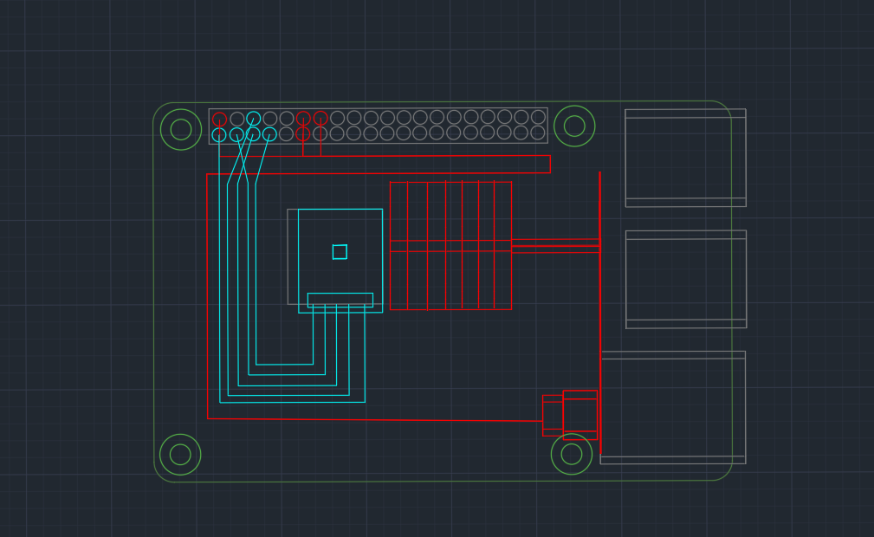
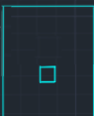
Configuration - Top View
22mm
13mm
18.8mm
40mm
1mm
27mm
10mm
18.5mm
2mm
5mm
8mm
Notes:
Michael (include how far the magnetometer is from the top edge of this view)
Here is a 2D top view of our payload
Labeled in white are the dimensions of our instruments.
The magnetometer itself measures 2mm by 2mm by 1mm, and
the distance from the electromagnet to the center of the magnetometer is 10mm.

Slide 23
Concept of Operations
Control Program is launched on Pi boot up.
Control Program launches all required programs.
Monitor Program manages data and system status.
Phase 1
Magnet and Sensor Program’s data is moved by Transfer Program.
UAH’s Program processes data from Transfer Program.
Control Program processes data and manages any problems.
If any error is encountered, it is logged and the system is restarted.
Phase 2
Payload collects data at a rate of 60 samples/minute continuously.
Data collected is compared to data of an identical payload on Earth.
Conclusions are drawn, hypothesis is supported or refuted.
Phase 3
Notes:
Sam
For our concept of operations, we have three phases. The first phase is dedicated to the initiation of the program, where the control program will boot up the Pi, launch all the required programs, and the monitor program will begin managing the data and system status. Phase 2 establishes other necessary systems dedicated to payload success. The instrument programs’ data will be moved and collected via the transfer program, which will then be sent to UAH’s data collection program. If any error is encountered in the system at this point, the payload will log it and the system will restart. For Phase 3, the experiment will begin and the payload will collect data at a rate of 60 samples per minute continuously. Data collected will then be compared to data form an identical payload on Earth functioning as the control. From there, the data will be analyzed and conclusions will be drawn either supporting or refuting the hypothesis.

Slide 24
Functional and Operational Testing
Notes:
Emann
We will now move on to Functional and Operational Testing.

Slide 25
Functional Requirements
The completed program shall:
Perform basic tasks
Take Measurements
Organize Data Packets
Send Data in packets less than 5 kilobytes per second
Maintain on/off cycle to prevent overheating of magnetometer
Establish a controlled electromagnetic field to perform testing on
Notes:
Emann
Our project’s functional requirements are to send data in data packets less than 5 kilobytes/s, to establish an EMF with an electromagnet, and to measure the changes in the EMF using a magnetometer to compare its difference with the data we collect on Earth.
The payload will also maintain an on/off cycle in order to prevent overheating
The payload must create a controlled EMF to perform testing on

Slide 26
Functional Testing
Functional Test | Requirement | Status | Comments
Utility Test | Take Measurements, Organize Data Packets, and Send Data | Passed, 0.3kBps | Peak data rate of 0.6 kBps, no problems encountered.
Afterburn Test | Prevent Overheating | Passed | 30 seconds on and 180 seconds off. 30/120 worked, added 1 min for flexibility
EMF Test | Establish a controlled EMF | Passed | EMF has a strength of 1.5 gauss and is steady (+/- 0.005g).
Notes:
Emann (do the data center test, make sure the right number of data is being sent)
The functional tests completed include the utility test, the afterburn test and the EMF test. The utility test determines the pi’s ability to do the basic functions, to make measurements, organize data and to send data. The afterburn test, a test designed after Michael discovered a heating issue , made to test for overheating. The test established an on/off cycle for the payload, which solved the overheating issue. The EMF test was made to determine if the pi could establish an EMF, that would be maintained within the constraints named in the ICD and RFE. UAH advised that our electromagnet remained under 2 gauss.

Slide 27
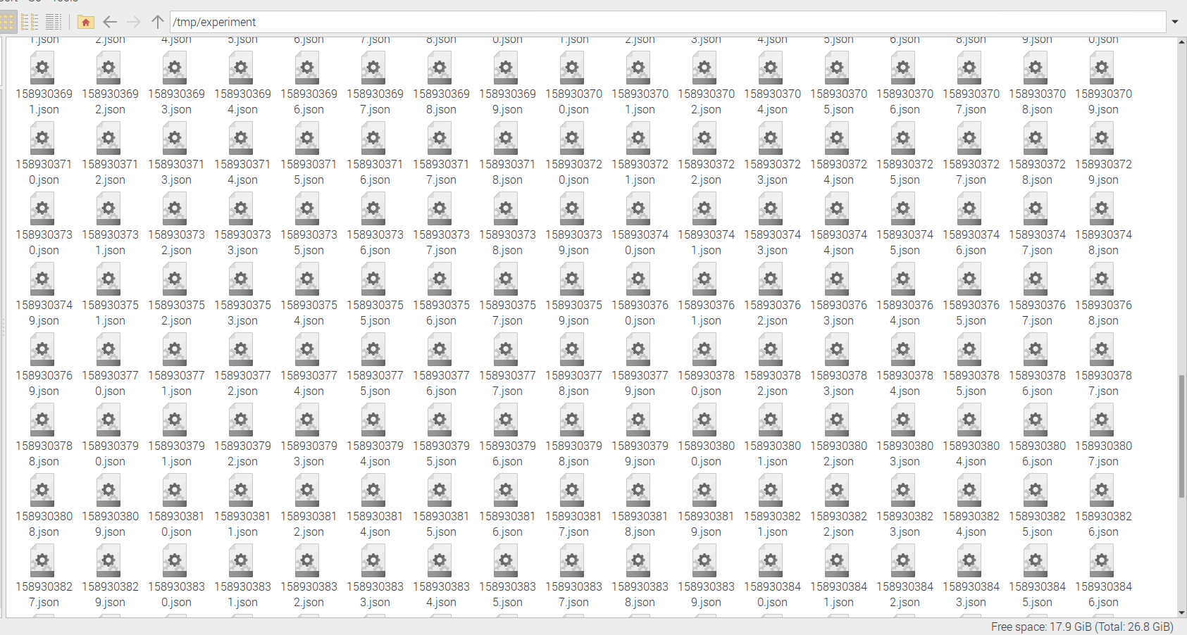
Utility Test
Reason for Test
Show that program can take measurements, organize data packets, and send data
Demonstrate ability of programs to run autonomously and function as expected.
Test Environment
The experiment was done 6 times, 3 with a monitor attached (30 min), 3 headless (30 min).
No user input was allowed, but UAH’s team-sender program was disabled to prevent the deleting of the data files in /tmp/experiment
Results
Pass
The programs all worked as expected, data was transferred in time stamped files to /tmp/experiment
Data rate was 0.3 kBps
If magnet output data simultaneously, data rate is 0.6 kBps, well below 5 kBps maximum in ICD.
Evidence
A picture of the populated /tmp/experiment folder after a headless test. (542.4 kB in folder)
Notes:
Emann (work with Michael to create speaker notes,)
The Utility Test was designed to determine if the program could take measurements, organize data packets and send data. The test would also determine if the program could run autonomously and function as expected.
The test was runned 6 times, 3 times with a monitor attached and 3 without the monitor, which is also known as a headless test. The test was run without user assistance but the UAH’s team-sender program was disabled to prevent the deleting of the data files in our file folder.
The test was an eventual success and the program proved to function properly as seen from the /tmp/experiment folder. The measured data rate was 0.3kBps, when combined with the magnet output data simultaneously, will add to a total data rate of 0.6kBps, meeting the data rate constraint of 5bps

Slide 28
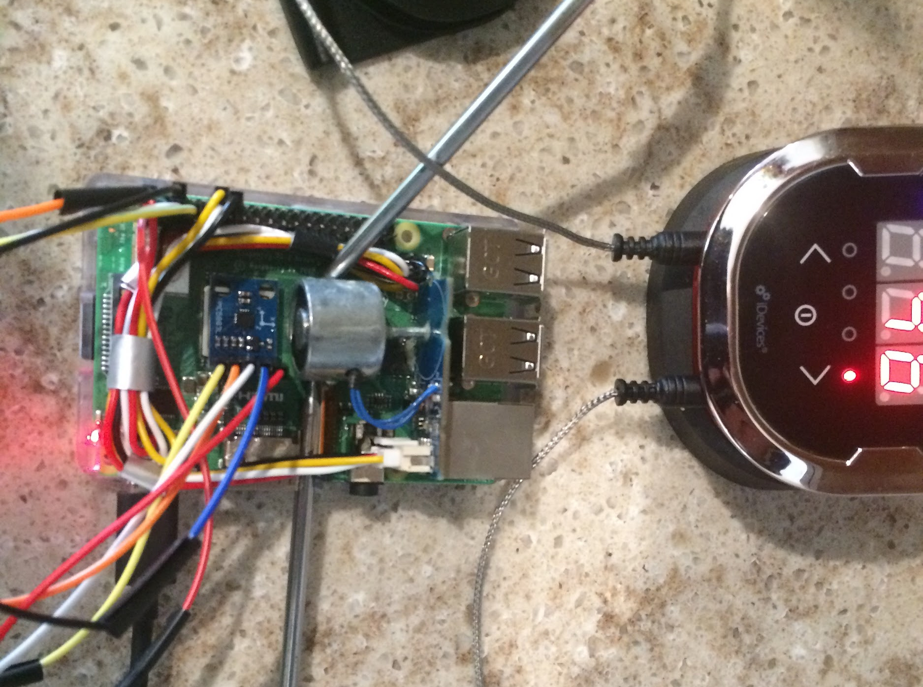
Afterburn Test
Reason for Test
Electromagnet heats up if left on for extended periods of time.
Verification that the magnet will not heat up via on/off cycle.
Test Environment
The test was done 3 times (120 minutes), each time with 2 external thermometers.
Goal is for the temperature to stabilizes at or below 40°C
Results
Pass
During this test we optimized the magnet for the best tradeoff in data collection without overheating
At 30/180, the electromagnet stabilized at 35°C in all 3 tests (23°C ambient temperature).
Evidence
thermometers
Notes:
Emann (work with Michael to create speaker notes)
The Afterburn test was designed with the intention of testing for overheating as the electromagnet heats up over time. The test was made to determine the effectiveness of an on/off cycle to prevent the overheating of the payload.
This test was performed 3 times for 2 hours each, and with 2 external thermometers for each run shown in the picture shown. The Goal of this test was to determine if the temperature stabilizes at or below 40 degrees celsius.
The payload passed the test and the the magnet was optimized for the best tradeoff in data collection without overheating.
The on/off cycle currently in place has the electromagnet function 30 second on, 3 minutes with it off and stabilizes the electromagnet at 35 degrees celsius in all 3 tests alongside an ambient temperature of 23 degrees celsius.

Slide 29
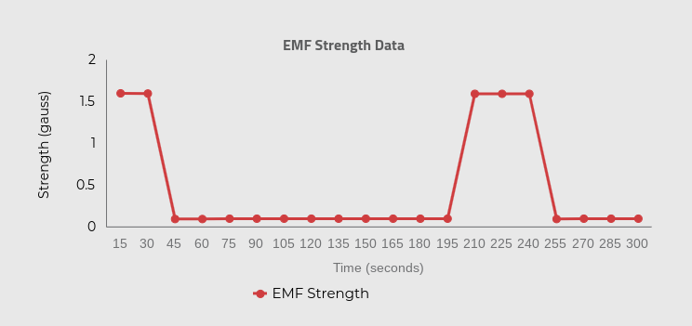
EMF Test
Reason for Test
Successfully generate and measure an EMF using a magnetometer and electromagnet.
Demonstrate accuracy of sensor.
Test Environment
The test utilized the data from the Utility test, and analyzed it for the successful creation of an EMF.
There was no outside interaction, the payload was connected to a stable power source, and every other impactful external variable was controlled.
Results
Pass
The magnetometer was able to accurately measure the EMF generated by the electromagnet with an accuracy of +/- 0.005 gauss.
Data collected shows an increase of ~1.5 gauss over a 30 second time period, as expected.
Evidence
Notes:
The EMF test was designed to demonstrate that our payload is capable of generating and measuring with a high degree of accuracy an Electromagnetic field.
This test was completed with data collected during the Utility test, and it successfully demonstrated that the magnetometer was able to measure an EMF with an accuracy of plus or minus 5 milligauss without user assistance.
The picture shown is a graph made from the compiled data collected, with EMF strength in gauss on the Y-axis and time in seconds on the X-axis.

Slide 30
Operational Requirements
The experiment configuration shall survive in the following conditions:
Survive Launch, experiencing 18 gs of force and vibrations
Remain Functional after a week in -30℃ to -20℃ (-22℉ to -4℉)
Operate within a temperature range of 40℃ to 60℃ 104℉ to 140℉)
Survive and operate in vacuum-like pressures
Notes:
Dalton (replace week with no power, with vacuum, match order)
Edit Later
*Match up operational requirements to operational testing*
Dalton
To survive and operate in the environment on the ISS, the pi must survive launch, remain functional after a week without power, remain functional after a week in temperatures ranging from -20C to -30C. Lastly the pi must operate in a temperature range of 40C to 60C. Next Slide please

Slide 31
Operational Testing
Operational Test | Requirement | Status | Comments
Heat Test | Survive Hot Environment | Passed | Performed normally under increased temperatures
Chill Test | Survive Cold Environment | Passed | Performed normally after decreased temperatures
Rumble Test | Survive Random Vibrations | Passed | Incredibly stable, withstood extremely violent shaking for an extended period of time.
Vacuum Test | Survive Extreme Pressures | Passed | Performed normally after decreased pressure
Notes:
Dalton
For Operational Testing, the goal was to mimic the situations and simulate how our pi will operate before, during and after launch. As such we have two temperature tests to account for the temperature extremes during the mission. The Bike test will be used to simulate the random vibrations of the space shuttle before launch. Lastly, a safe and functional vacuum chamber will be used to simulate the microgravity environment that the pi will experience.
Change to pressure, specify the heat, chill, vacuum, and bike test (clarifications is good) and their implications

Slide 32
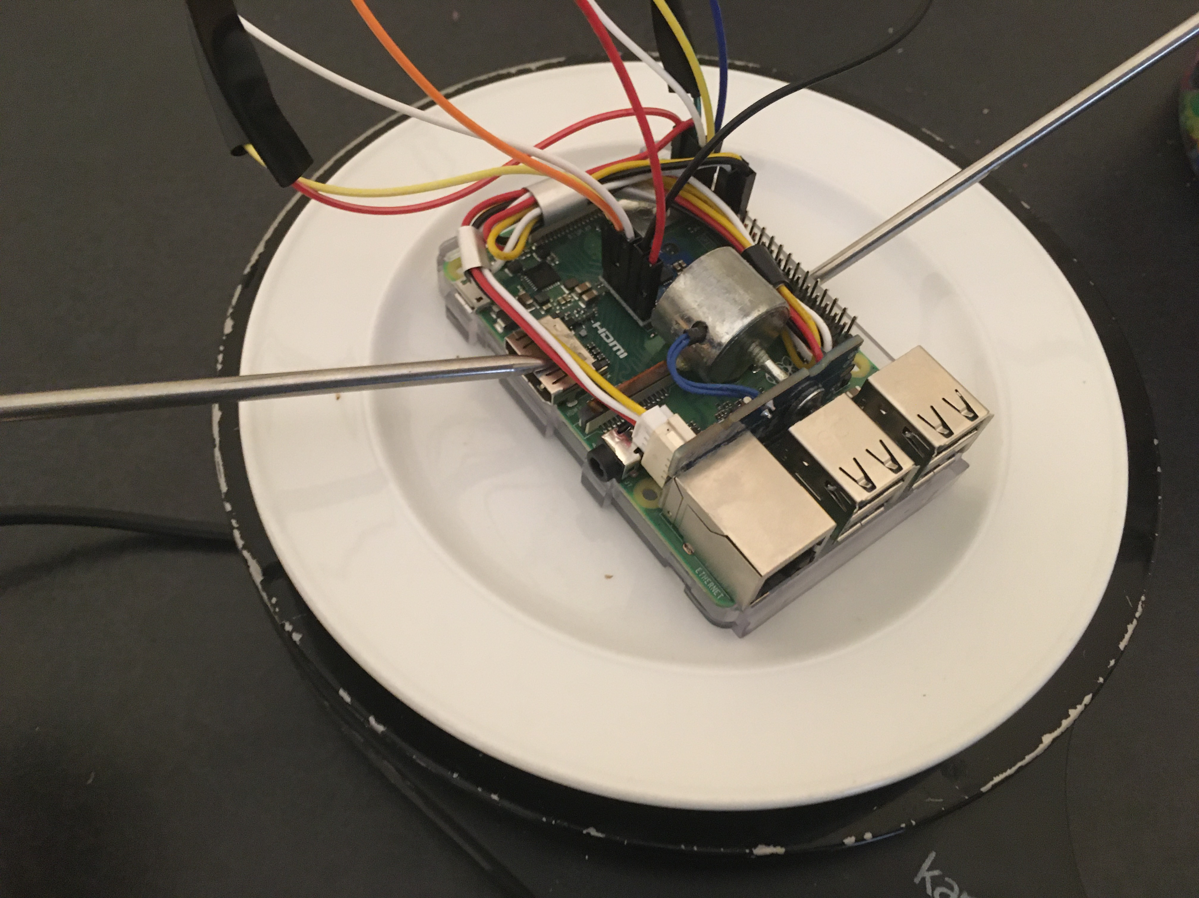
Heat Test
Reason for Test
Demonstrate ability to operate in a heated environment
Operate within a temperature range of 40℃ to 60℃
Test Environment
Raspberry Pi was placed on hot plate with a cover (not pictured) for 1 hour
First 30 minutes simulated temperatures from 40℃ to 50℃, second 30 minutes simulated 50℃ to 60℃
Results
Passed
Data collected during test was consistent with data gathered while at room temperature
No complications discovered with on/off cycle for magnetometer
Evidence
thermometers
heat plate
Notes:
Dalton (work with Sam to create speaker notes)
The Heat Test was designed to determine if the program could operate in a heated environment with a range of 40℃ to 60℃
The test was run 2 times, where the Raspberry Pi was placed on hot plate with a cover (not pictured) for 1 hour
The First 30 minutes of each test simulated temperatures from 40℃ to 50℃, and the second 30 minutes simulated 50℃ to 60℃
In the end, the payload passed the test, as data collected during the test was consistent with data gathered while at room temperature
Furthermore, no complications discovered with on/off cycle and overheating for magnetometer during the test.

Slide 33
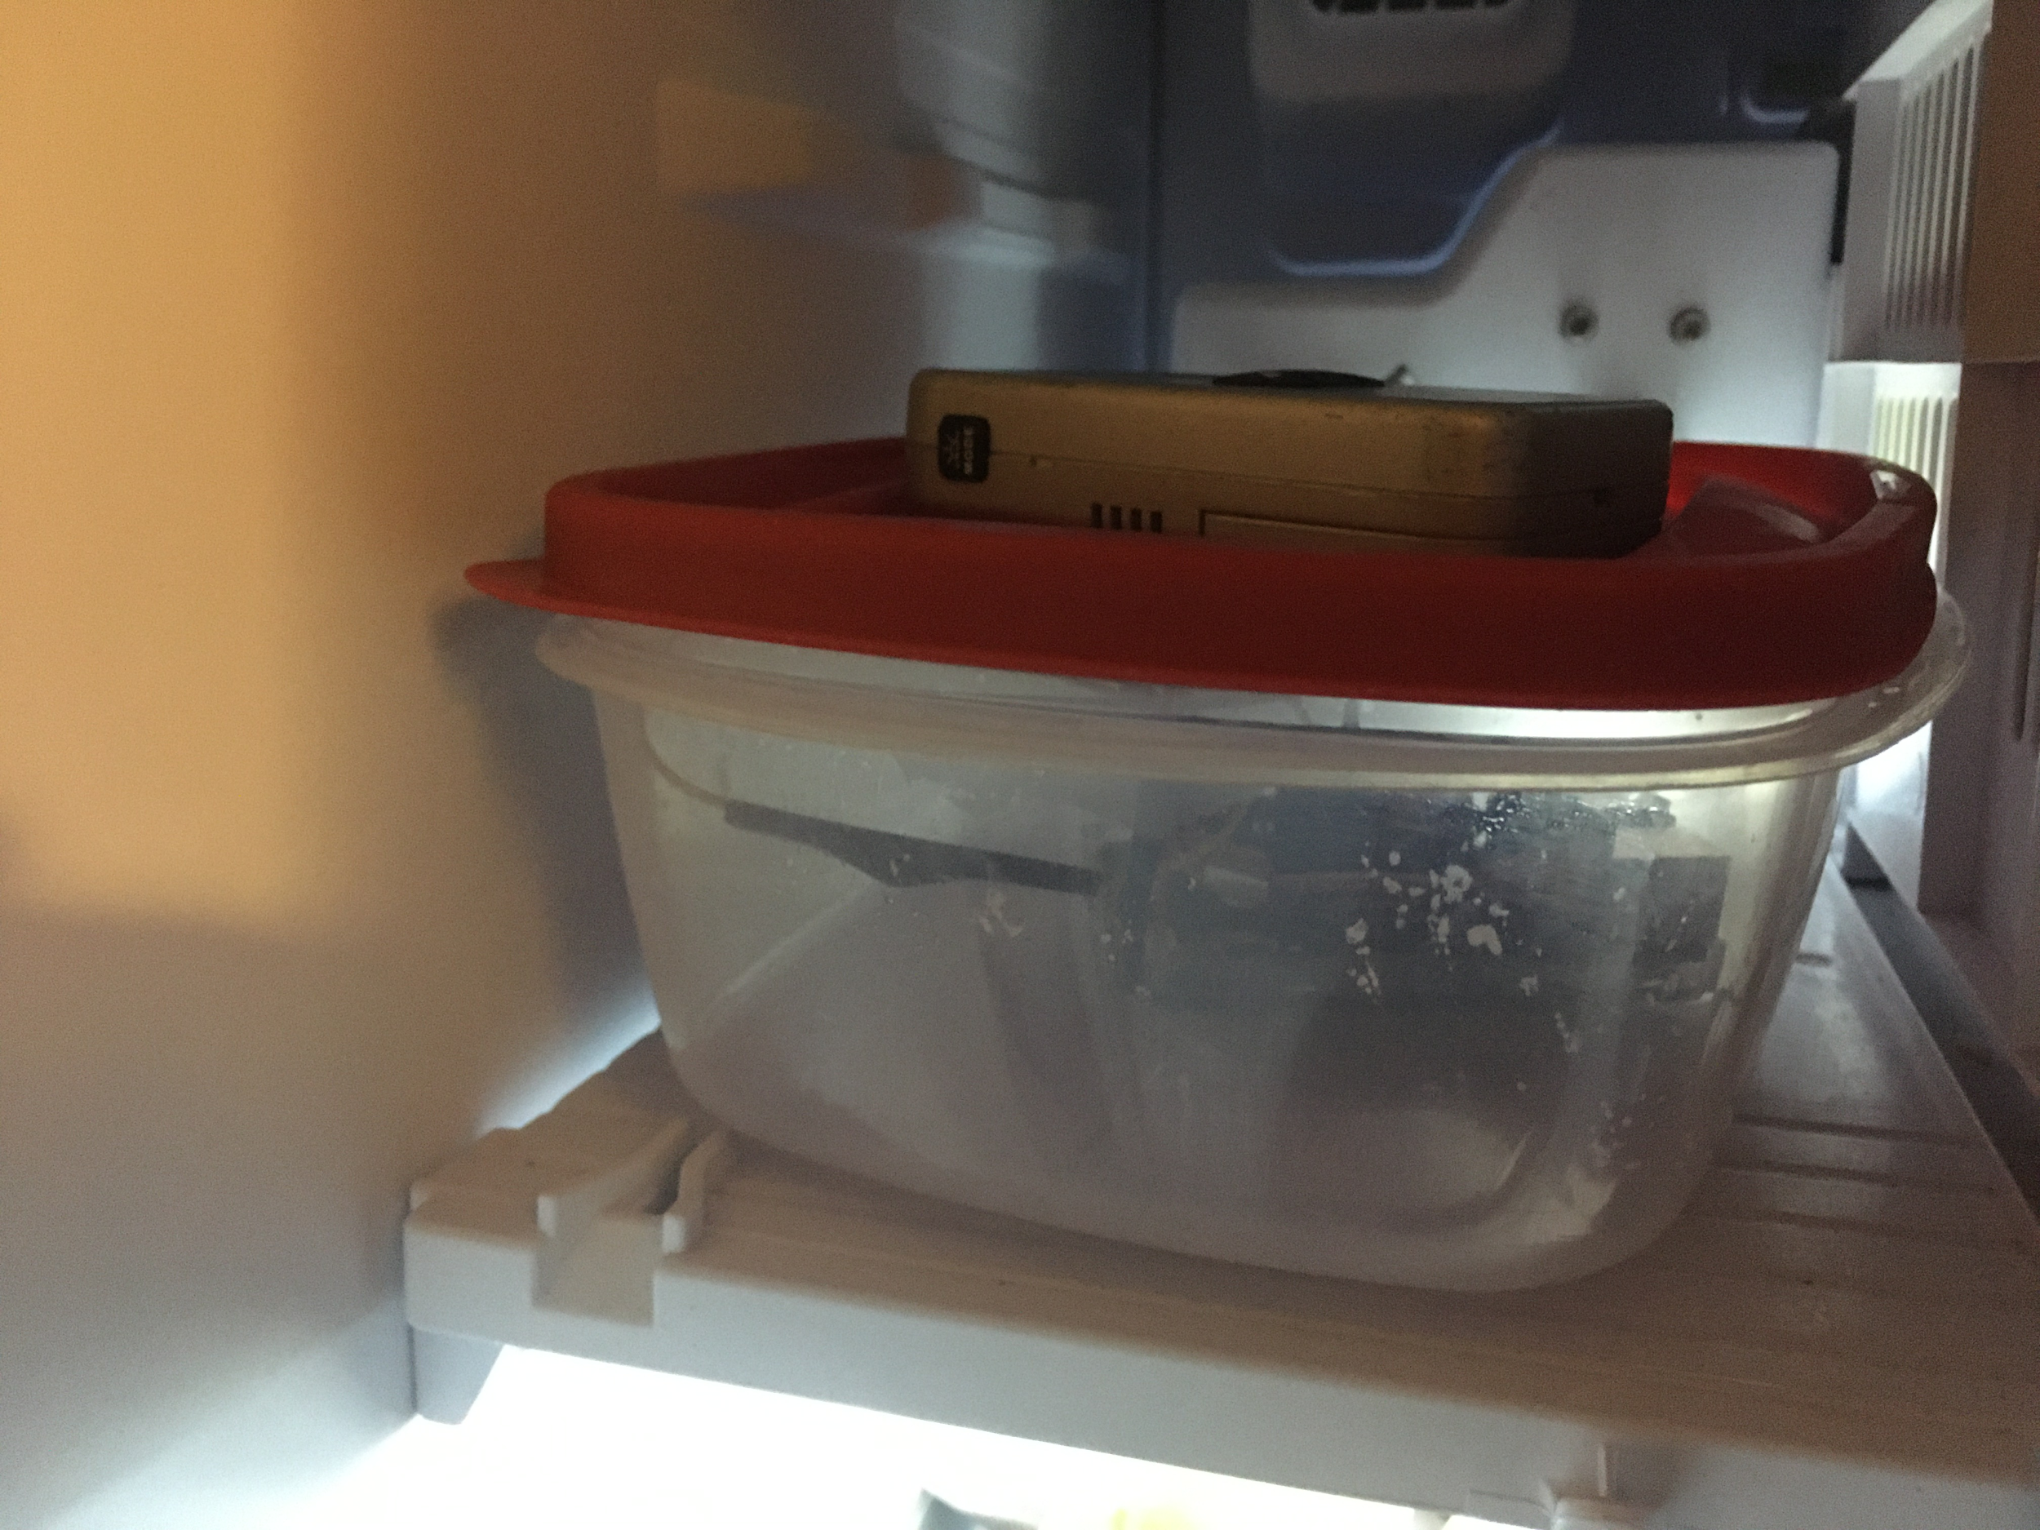
Chill Test
Reason for Test
Demonstrate ability to operate after experiencing a cold environment
Remain Functional after a week in -30℃ to -20℃
Test Environment
Raspberry Pi was placed in freezer for 12 hour period
Temperatures range from -8℃ to -32℃ with measurements taken every half hour
Placed in airtight container to control for moisture
Results
Passed
Data collected during test was consistent with data gathered while at room temperature
Payload did not suffer from any moisture damage
Evidence
thermometer
Notes:
Dalton (work with Sam to create speaker notes)
The Chill Test was designed to determine if the program could operate in a cold environment with a range of -20℃ to -30℃
The test was run 2 times, where the Raspberry Pi was placed in freezer for 12 hour period. During testing, temperatures range from -8℃ to -32℃ with measurements taken every half hour. The payload was also placed in airtight container to control for moisture
In the end, the payload passed the test, as data collected during the test was consistent with data gathered while at room temperature
The payload also did not suffer any physical damage for the slight increase of moisture even in the airtight container.

Slide 34
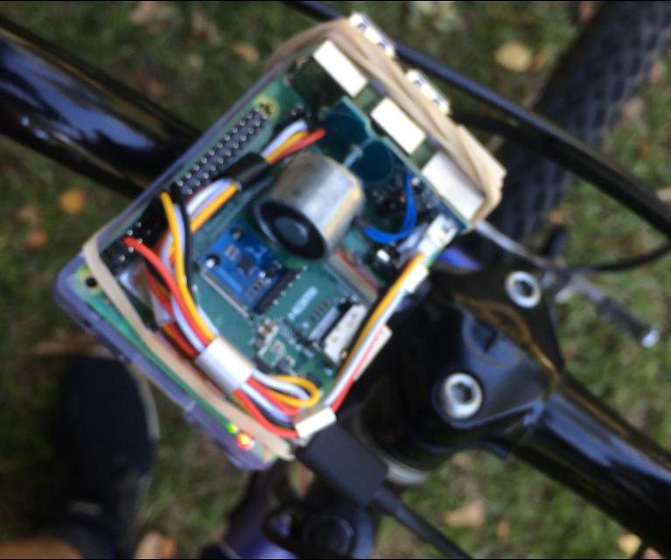
Rumble Test
Reason for Test
Demonstrate structural stability of payload.
Verify with a high degree of confidence the ability of the payload to withstand launch conditions.
Test Environment
First, we powered the Pi on and attached it to the handlebars of a mountain bike. Then, we took it on an hour long (rough) bike ride.
Then, for 15 minutes it was shaken by the base as violently as possible.
Results
Passed
The payload did not budge. All electronics were secured and withstood the most violent shaking with ease.
All mounting hardware was checked thoroughly after this test
Data collected during test was consistent with data gathered while stationary
Evidence
Notes:
Dalton (work with Sam to create speaker notes)
The Rumble Test was designed to determine if the program could operate under launch conditions while maintaining structural stability.
First, we powered the Pi on and attached it to the handlebars of a mountain bike. Then, we took it on an hour long (rough) bike ride.
Then, for 15 minutes it was shaken by the base as violently as possible.
In the end, the payload passed the test, as data collected after the test was consistent with data gathered while stationary. The payload did not budge. All electronics were secured and withstood the most violent shaking with ease.
Lastly, all mounting hardware was checked thoroughly after this test, and no problems were discovered.

Slide 35
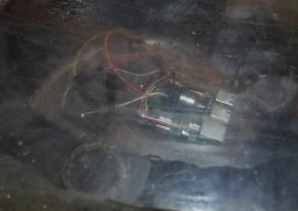
Vacuum Test
Reason for Test
Demonstrate equipment can survive the vacuum of space for the duration of the mission
Verify payload could physically withstand very low pressures
Test Environment
Raspberry Pi placed inside of vacuum chamber, and the chamber then set to -27 bar of pressure
Pi was left inside chamber for one hour
Results
Pass
No damage was found on the payload after testing
Data collected was consistent with data collected under normal atmospheric conditions
Evidence
Notes:
Dalton

Slide 36
Bonus Content -
Outreach
Notes:
Morgan
Say something like: This is our bonus content, in the form of outreach

Slide 37
Outreach Overview
We decided to use our bonus content to work on an outreach project focused around science and math.
Our goal was to look deeper into a drop we noticed, from a previous study we did last semester, in middle school students specifically a drop in their understanding of importance and liking of math and science.
We chose to do this because without science and math we wouldn’t have opportunities like this one.
We Accomplished This By:
Surveying our school’s middle school students
Our survey asked them to
rate on a scale from one to ten about their liking and importance understanding of math and science
write what they like and dislike about math and science specifically
Analyzed the data and drew our own conclusions
Notes:
Morgan
From the INSPIRESS competition we participated in last semester, we learned that there is a significant drop in math and science liking and interest in middle school. We wanted to know why and if there’s any way, even in our own school, to fix this issue.
We originally wanted to survey our school and the general public, but due to COVID-19 we had to change our plans. We originally wanted to fix not being able to host events with an online survey. We shared it with our peers and other teams but a lack of response made it ineffective. Now, we are going to focus on our school. Specifically 6th through 8th grade.
We wanted to do this because without science and math we wouldn’t have this opportunity. And by what we have seen with our study and other studies that have looked at the same thing, is that this drop in middle school is universal. It must be something we’re doing. So how can we adapt and fix it?
We surveyed the middle school with a survey from UAH that we modified with our own short answer portion. After collecting and analyzing the data we drew our own conclusions which are shown on the next slide.

Slide 38
Outreach Investigation
6th Grade
Overall Scoring Higher On Average:
Science Importance ~ Male
Science Liking ~ Male
Math Importance ~ Female
Math Liking ~ Female
Short Answer Response Conclusions:
Math
Students like when they learn through engaging activities, and dislike the amount of homework they recieve.
Science
Students like using engaging activities and projects, and dislike just taking notes.
7th Grade
Overall Scoring High On Average:
Science Importance ~ Female
Science Liking ~ Female
Math Importance ~ Female
Math Liking ~ Female
Short Answer Response Conclusions:
Math
Students like that their teachers are engaging, and dislike the amount of content and the difficulty
Science
Students like using engaging activities and projects, and dislike lack of engagement.
8th Grade
Overall Scoring High On Average:
Science Importance ~ Female
Science Liking ~ Male
Math Importance ~ Male
Math Liking ~ Female
Short Answer Response Conclusions:
Math
Students like the content being taught and how their teacher are teacher them, and dislike the amount of stress.
Science
Students like engaging labs and activities and projects, and dislike their teacher.
Notes:
Morgan
From my results I noticed one thing, middle school is a time where students as people go through the most change mentally. That means that school’s need to make how and what we learn in middle school adaptive to each grade and in some cases each student. Here’s what we learned...
In 6th grade, overall, boys do better in science and girls do better in math. 6th grade students in math like learning through activities that actively engage them, and dislike having a lot homework. When it comes to science it’s the same for the activities, but instead of homework they dislike notes.
This makes sense, these kids are younger and enjoy learning through engagement and not just sitting in class taking notes or spending lots of time at home doing homework.
In 7th grade, overall female do the best across the board. My hypothesis is that once again we don’t tailor how we are teaching to the age. It more than just what we choose to teach them at what age it’s how. Just like 6th grade, students in math and science both enjoy having engaging activities and want to do them more. They in both science and math dislike the time requirement and a lack of engagement.
Finally in 8th grade, right before the transition to high school, we see that in both math and science, they enjoy what they are learning, just not how. They dislike the amount of stress placed on them and rather spend time enjoying actively learning through activities.
In conclusion, overall, we see one common answer...engagement. In middle school, even as I remember, teacher’s always stressed us about being ready for high school and try to treat like we’re already there as much as possible. I think that from what we learned from our surveys, we need to stop treating middle school students like the high school students their not yet, and treat them like the ages they are. Their younger and I think that we could see major improvement in this drop if we change how we’re teaching to be custom to them.

Slide 39
Summary
Notes:
Morgan

Slide 40
ICD Requirements Checklist
Requirement | Verification | Compliance
No larger than 65 x 56.5 x 19 mm | 62 x 56 x 19 mm | ✓
Securely mounted to the Pi | Passed Rumble Test | ✓
Interfaces with the 40-pin GPIO header on a Raspberry Pi 3B+ | Passed Utility Test | ✓
5 kBps or smaller data rate | Passed Utility Test, 0.6 kBps max | ✓
JSON formatted data packets delivered to the /tmp/experiment/ folder | Passed Utility Test | ✓
No potential harm to AR2A mission, EMF below 2 gauss | Emits 1.5 gauss | ✓
Notes:
Morgan
The first requirement is that the payload is no larger than sixty-five by fifty-six and a half by nineteen millimeters. Our payload is sixty-two by fifty-six by nineteen millimeters, meeting the spatial requirement.
The second requirement is that the payload needed to be securely mounted to our Pi, we verified this by performing a rumble test.
We also verified that our payload can successfully interface with the forty pin header on Pi via the utility test.
Our payload needed to have a data rate of five kilobytes per second of less, and to do this our payload passed a utility test and has a max of zero point six kilobytes per second max.
We verified that our payload can package data successfully into JSON packets and move those packets to /tmp/experiment/ folder via the utility test.
We also needed to make sure that our payload didn’t harm to AR2A mission in any way and have a EMF below two gauss, and our payload emits one point five gauss.

Slide 41
Lessons Learned
Leadership
We learned to adapt to different methods of virtual communications and teamwork.
An unexpected complication arose from the coronavirus which forced us to become more coordinated with the planning and transportation of the payload.
If we could do something differently, we would reorient after school was canceled faster, as we wasted valuable time waiting to see what changes were going to be made.
BC - Outreach
We learned to modify our plan to reach our goal despite obstacles, but adapt how we do so in a timely and effective manner.
Coronavirus proved to be a huge obstacle that pushed us to work with what we already had before school was cancelled in the most productive and efficient way as possible.
If we could start again, and not have outside forces effective our ability to work, I would have liked to complete the same goal just on a larger scale.
Notes:
Sam (leadership), Morgan (outreach)
Learn how to adapt to different situations and different methods of communications - Leadership?
Plans always go awry and back-ups are needed greatly.

Slide 42
Lessons Learned
Design & Programming
We learned the importance of planning ahead of time, and expanded our knowledge of programming and design.
We had to learn new protocols and functions to program the payload, and were faced with a big challenge, as we weren’t able to work face to face for most of the project.
We would use an online repository to organize our edits, as saving each edit as an individual file was extremely confusing.
Testing
We learned the importance of multiple trials, as well as the value of longer test periods. It took the electromagnet about 30 minutes to heat up to 35°C, and another 30 minutes to determine the temperature had stabilized.
We did not fully comprehend that testing would take so long and be so high maintenance. During the afterburn test, temperature data was gathered every 2 minutes, for an hour, 3 times over.
If we were to do this project again, we would focus on assembling the payload as soon as possible to allow more time for testing.
Notes:
Ben (programming), Dalton/Emann (testing)
Learn how to adapt to different situations and different methods of communications - Leadership?
Plans always go awry and back-ups are needed greatly.

Slide 43
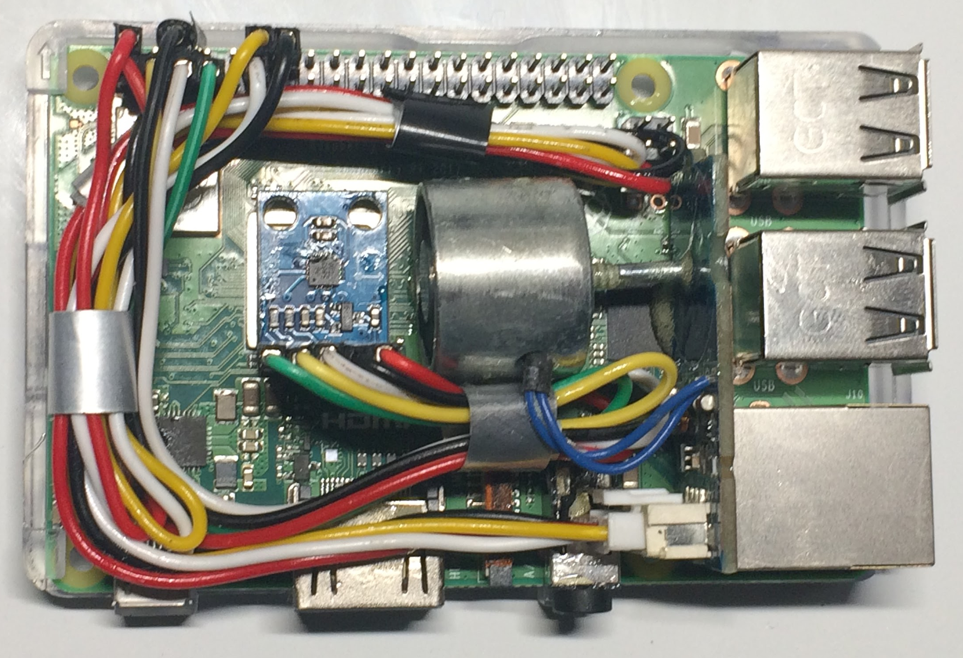
Summary
Design Summary | Science Objective: Effects of Earth’s Magnetic Field on EMF Strength Configuration Instruments: Grove Pi Electromagnet and HMC5883L Magnetometer 62 x 56 x 18.8 mm, emits 1.5 gauss Outputs 0.3 kBps, max 0.6 kBps 6 Major Program Parts Control, Magnet, Transfer, Monitor program, UAH’s Data Send, and Restart
Testing and Verification | Testing Passed Functional: Utility - 0.6 kBps max Afterburn - On/off cycle EMP - 1.5 gauss Operational: Heat - Operated at 60℃ Chill - Operated after -32℃ Rumble - Survived vibration Vacuum - Survived -27 bar
Notes:
Sam
In summary, the science objective for our payload is the effects of Earth’s Magnetic Field on EMF Strength
THe payload consists of a Grove Pi Electromagnet and H-M-C-5-8-8-3-L Magnetometer and schematics of it can be seen to the side as well as the physical payload . It is 62 x 56 x 18.8 mm, and emits 1.5 gauss. It Outputs 03. kilobytes per second , with a max 0.6 kBps. The program consists of 6 major parts, a control program, magnet program, transfer program, monitor program, UAH’s data programs, and restart program.
The payload was tested to meet functional requirements, with the utility test testing its basic functions. HEre the payload operated correctly with a max kBps of 0.6. THe Afterburn test, solved an overheating problem with an on/off cycle. The EMP test demonstrated the successful establishment of an electromagnetic field with 1.5 gauss. Finally, the operational tests looked into the payloads environment survivability. By the end, the payload demonstrated its ability to survive from -32 degrees Celsius to 60 degrees, as well as survive heavy vibrations and vacuum conditions.
Thank you for listening to our presentation.

